Slide 1
Version Control with Git
Contents:
Git Basic concepts
File Management & Commits
Branches, Diff and Merges
Pull requests

Slide 2
Git Basic Concepts
Git is a Distributed Version Control tool that is used to store different versions of a file in a remote or local repository. It is used to track changes in the source code. Git favours both programmers and non-technical users by keeping track of their project files. It allows multiple developers to work together.
Git terminology
Name | Description
Repository | A repository contains the history, the different versions over time and all different branches and tags. In Git each copy of the repository is a complete repository
Branch | A branch is a named pointer to a commit. Selecting a branch in Git terminology is called to checkout a branch. If you are working in a certain branch, the creation of a new commit advances this pointer to the newly created commit.
Commit | When you commit your changes into a repository this creates a new commit object in the Git repository. This commit object uniquely identifies a new revision of the content of the repository.
HEAD | HEAD is a symbolic reference most often pointing to the currently checked out branch. Sometimes the HEAD points directly to a commit object, this is called detached HEAD mode. In that state creation of a commit will not move any branch.
Staging Area | The staging area is the place to store changes in the working tree before the commit.
Index | Index is an alternative term for the staging area.
Revision | Represents a version of the source code. Git implements revisions as commit objects (or short commits ). These are identified by an SHA-1 hash.
Tag | A tag points to a commit which uniquely identifies a version of the Git repository. With a tag, you can have a named point to which you can always revert to.

Slide 3
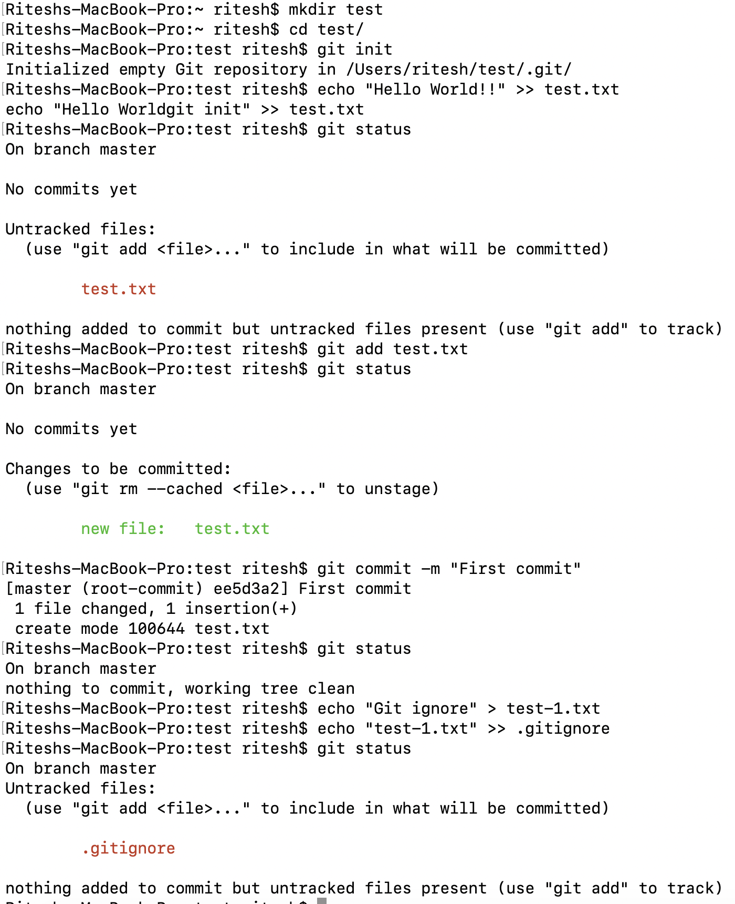
File Management & Commits
Git status : Initially, there are no files, and the tracked, ignored, and untracked sets are empty. Once you create data, git status reports a single, untracked file.
Git add : The command git add stages a file. In terms of Git’s file classifications, if a file is untracked, git add converts that file’s status to tracked. When git add is used on a directory name, all of the files and subdirectories beneath it are staged recursively.
Git commit : The -a or --all option to git commit causes it to automatically stage all unstaged, tracked file changes—including removals of tracked files from the working copy— before it performs the commit.
.gitignore : Editors and build environments often leave temporary or transient files among your source code. Such files usually shouldn’t be tracked as “source files” in a repository. To have Git ignore a file within a directory, simply add that file’s name to the special file, .gitignore:

Slide 4
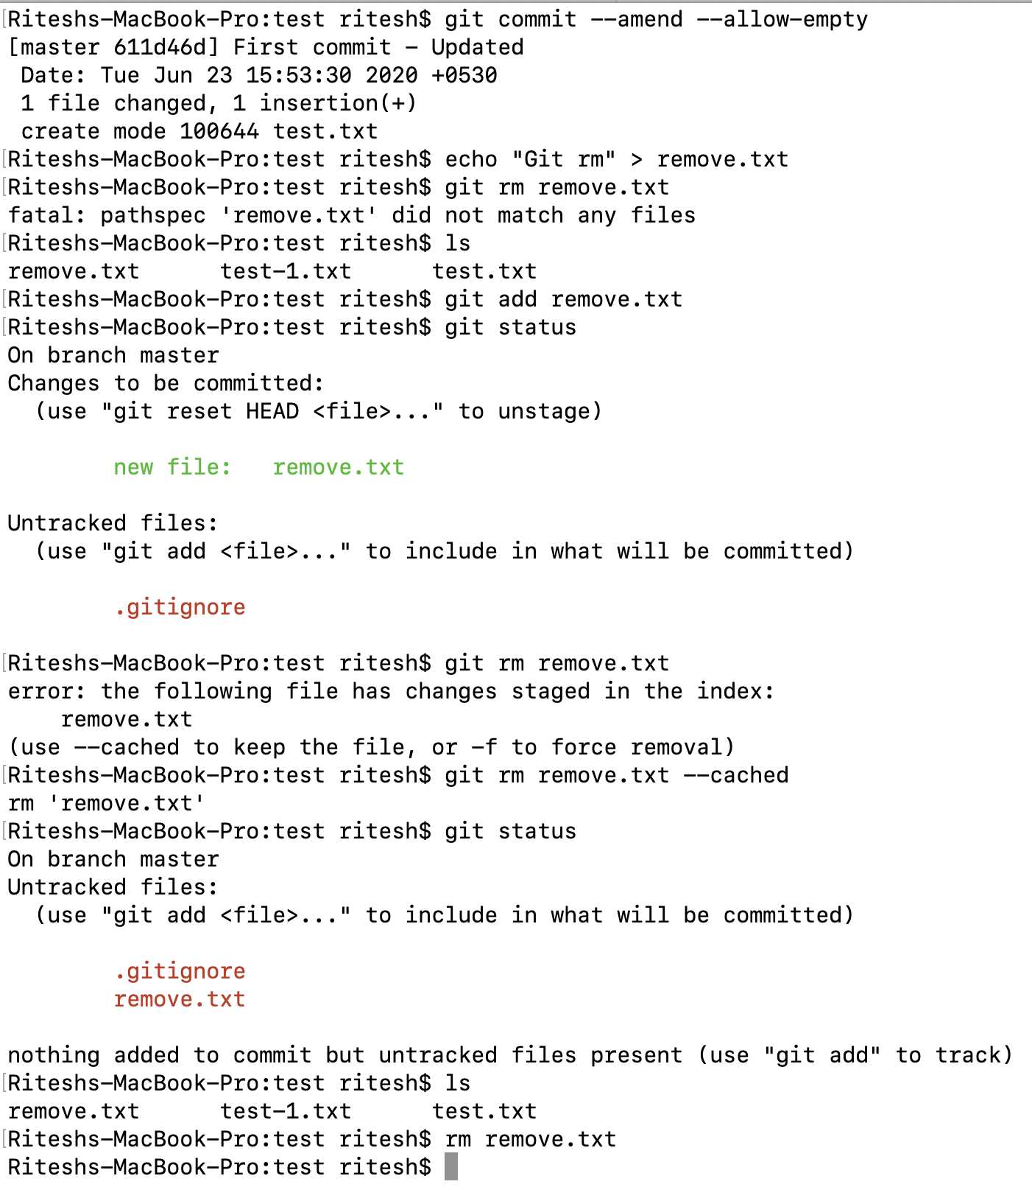
File Management & Commits – Cont’d...
Git commit amend & allow empty commit : It helps to modify commit message and allow commit even though there is no changes in repo.
Git rm : The command git rm is, naturally, the converse of git add.It removes a file from both the repository and the working directory. However, because removing a file tends to be more problematic (if something goes wrong) than adding a file, Git treats the removal of a file with a bit more care.
Git will remove a file only from the index or from the index and working directory simultaneously. Git will not remove a file from just the working directory; the regular rm command may be used for that purpose.

Slide 5
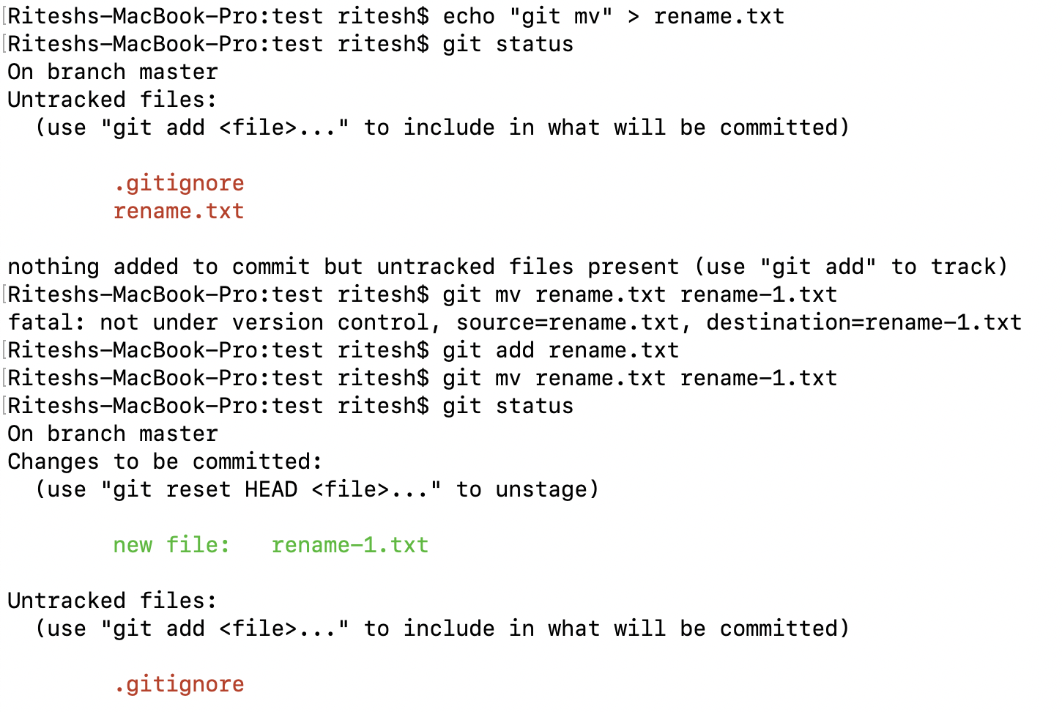
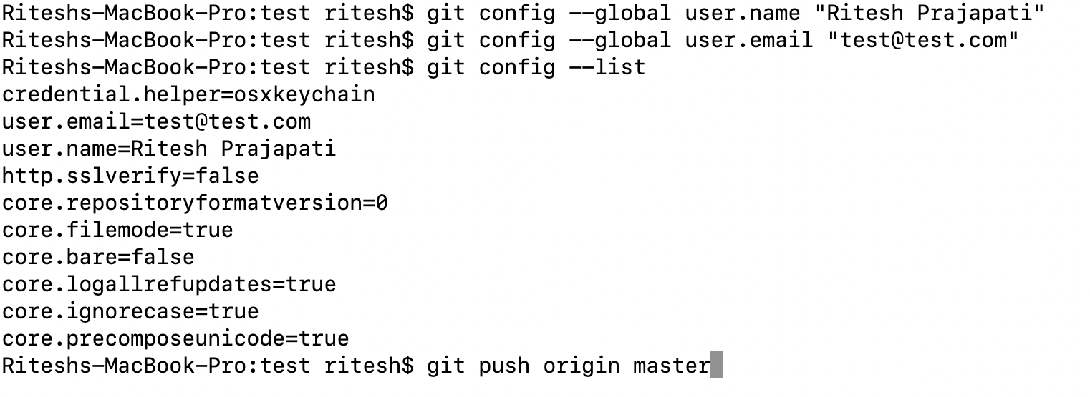
File Management & Commits – Cont’d...
Git mv : Suppose you need to move or rename a file. You may use a combination of git rm on the old file and git add on the new file, or you may use git mv directly.
Git push : command is used to transfer or push the commit, which is made on a local branch in your computer to a remote repository.
Git global config : Before you push changes, make sure valid identity is configured for git repo.
There are different configuration levels in Git. Configuration can be at three different levels.
They are:
System
Global
Repository

Slide 6
Branches, Diff and Merges
A Branch is the fundamental means of launching a separate line of development within a software project. A branch is a split from a kind of unified, primal state, allowing development to continue in multiple directions simultaneously and, potentially, to produce different versions of the project. Often, a branch is reconciled and merged with other branches to reunite disparate efforts.
Branch or Tag? A branch and a tag seem similar, perhaps even interchangeable. So when should you use a tag name and when should you use a branch name?
A tag and a branch serve different purposes. A tag is meant to be a static name that does not change or move over time. Once applied, you should leave it alone. It serves as a stake in the ground and a reference point. On the other hand, a branch is dynamic and moves with each commit you make. The branch name is designed to follow your continuing development.
Dos and Don’ts in Branch Names
Branch names must conform to a few simple rules:
You can use the forward slash (/) to create a hierarchical name scheme. However, the name cannot end with a slash.
No slash-separated component can begin with a dot (.). A branch name such as feature/.new is invalid
The name cannot contain two consecutive dots (..) anywhere.
Further, the name cannot contain:
— Any space or other whitespace character
— A character that has special meaning to Git, including the tilde (~), caret (^),
colon (:), question-mark (?), asterisk (*), and open bracket ([)

Slide 7
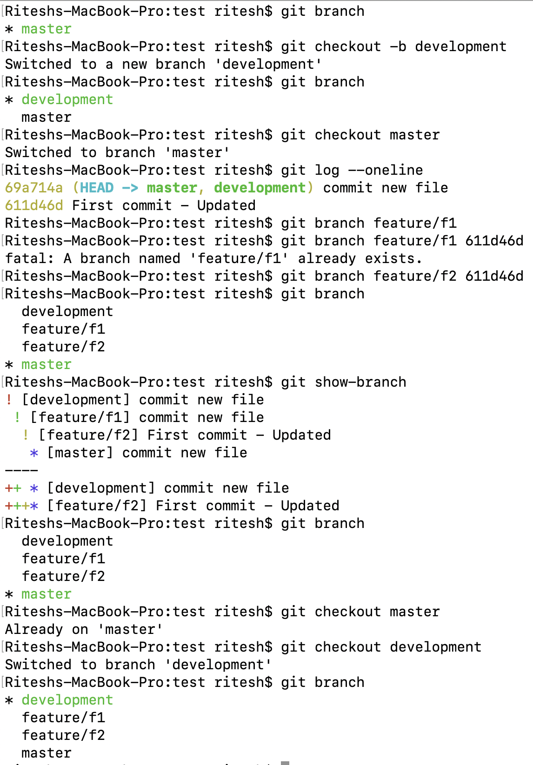
Branches, Diff and Merges – Cont’d…
Branches : Basic examples
Creating branch : #git checkout –b <branch-name>
#git branch <branch-name> <commit id>
Switch branch : #git checkout <branch-name>
Check current branch : #git branch
List all branches : #git show-branch
Delete branch : git branch –d <branch-name>
M
Merge Commit
C
Commit
B
Branch
C
B
M
M
M
M
M
M
M
M
M
B
Master
Pull Request
Pull Request
Pull Request
Pull Request
Pull Request
Pull Request
C
C
C
B
C
C
Development
Pull Request
C
C
C
C
C
C
C
C
Feature Branch

Slide 8
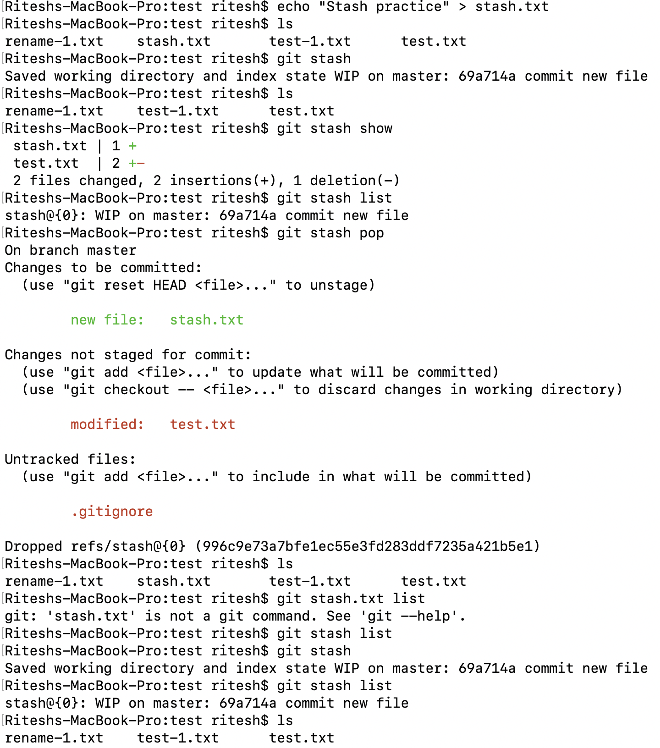
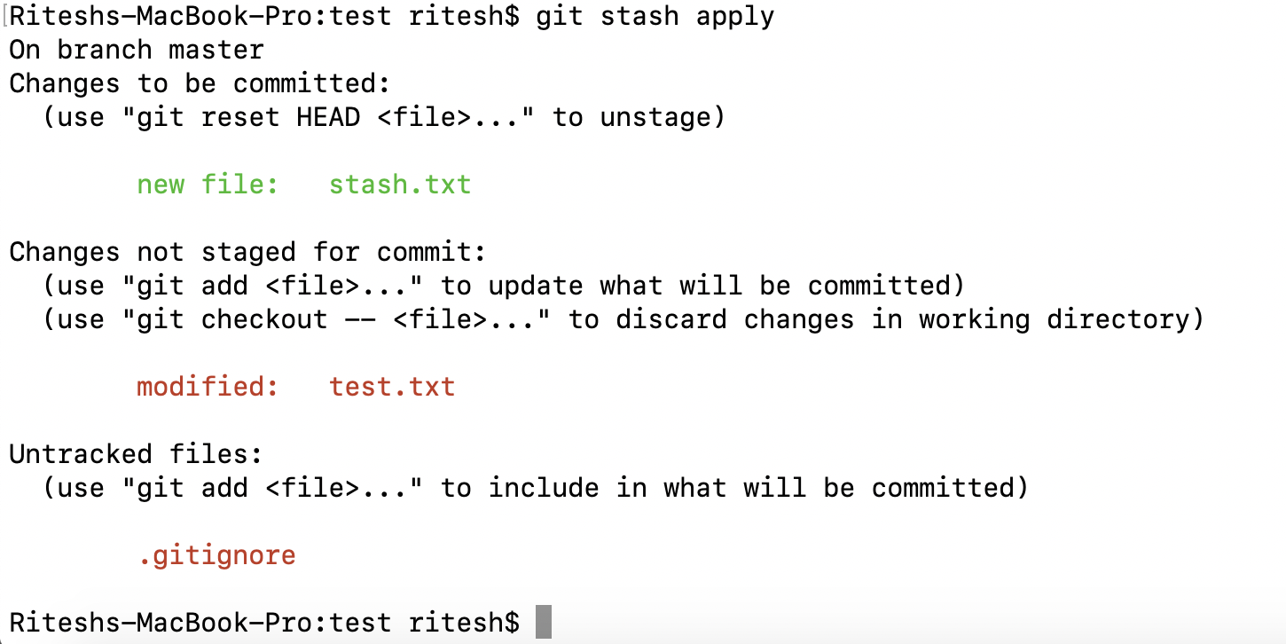
Branches, Diff and Merges – Cont’d…
Stashing your work :
The git stash command takes your uncommitted changes (both staged and unstaged), saves them away for later use, and then reverts them from your working copy. For example:
Stash your work : # git stash
Re-applying your stashed changes :
# git stash pop
(Popping your stash removes the changes from your stash)
Alternatively, you can reapply the changes to your working copy and keep them in your stash with
#git stash apply
To list stash : #git stash list
To show stash diff: #git stash show or #git stash show –p
To drop stash :
# git stash drop stash@{1} ( will drop specified stash)
# git stash clear ( will clear all stash)

Slide 9
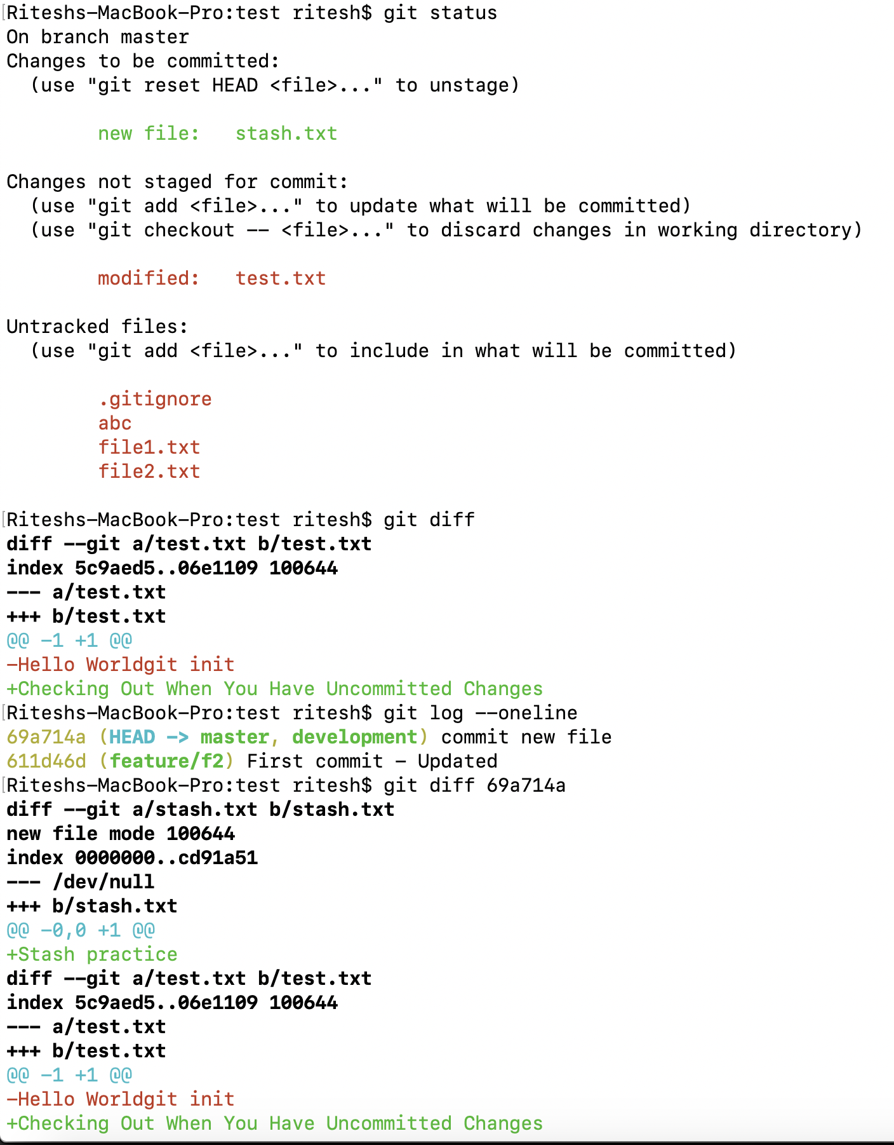
Branches, Diff and Merges – Cont’d…
The git diff command can perform four fundamental comparisons using various combinations of those three sources:
# git diff : shows the difference between your working directory and the index.
# git diff commit : This form summarizes the differences between your working directory and the given commit. Common variants of this command name HEAD or a particular branch name as the commit.
# git diff --cached commit
This command shows the differences between the staged changes in the index and the given commit. A common commit for the comparison—and the default if no commit is specified—is HEAD. With HEAD, this command shows you how your next commit will alter the current branch.
# git diff commit1 commit2
If you specify two arbitrary commits, the command displays the differences be- tween the two. This command ignores the index and working directory, and it is the workhorse for arbitrary comparisons between two trees that are already in your object store.

Slide 10
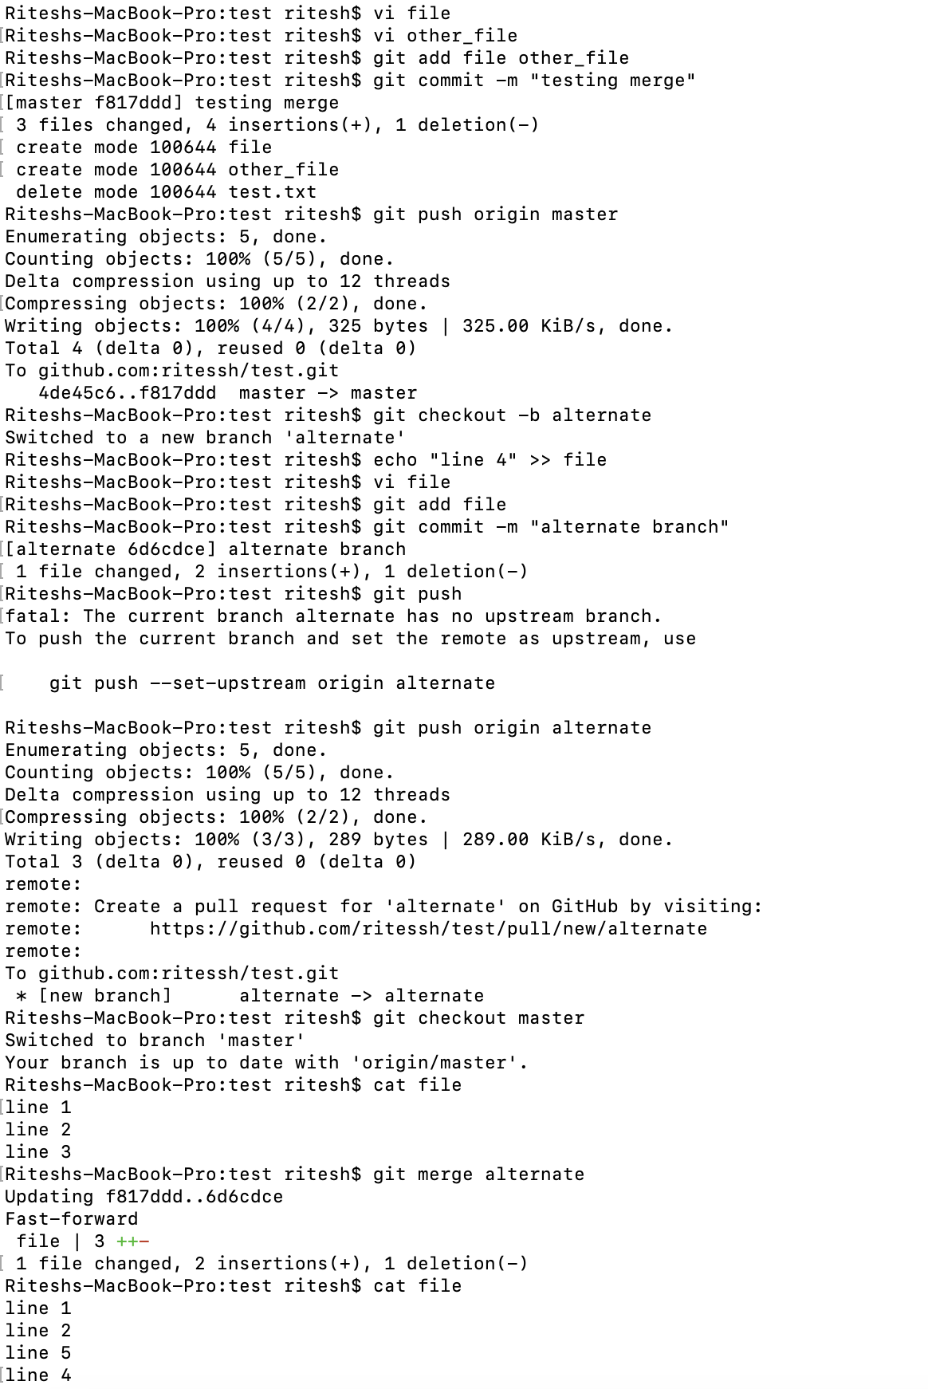
Branches, Diff and Merges – Cont’d…
Git merge
A merge unifies two or more commit history branches. Most often, a merge unites just two branches, although Git supports a merge of three, four, or many branches at the same time.
In Git, a merge must occur within a single repository—that is, all the branches to be merged must be present in the same repository.
Merging two branches (without conflict scenario)
# git checkout master
- create file & put some content
- run git add and git commit
# git checkout –b alternate
- edit file and update content
- run git add and git commit
#git checkout master
#git merge alternate

Slide 11
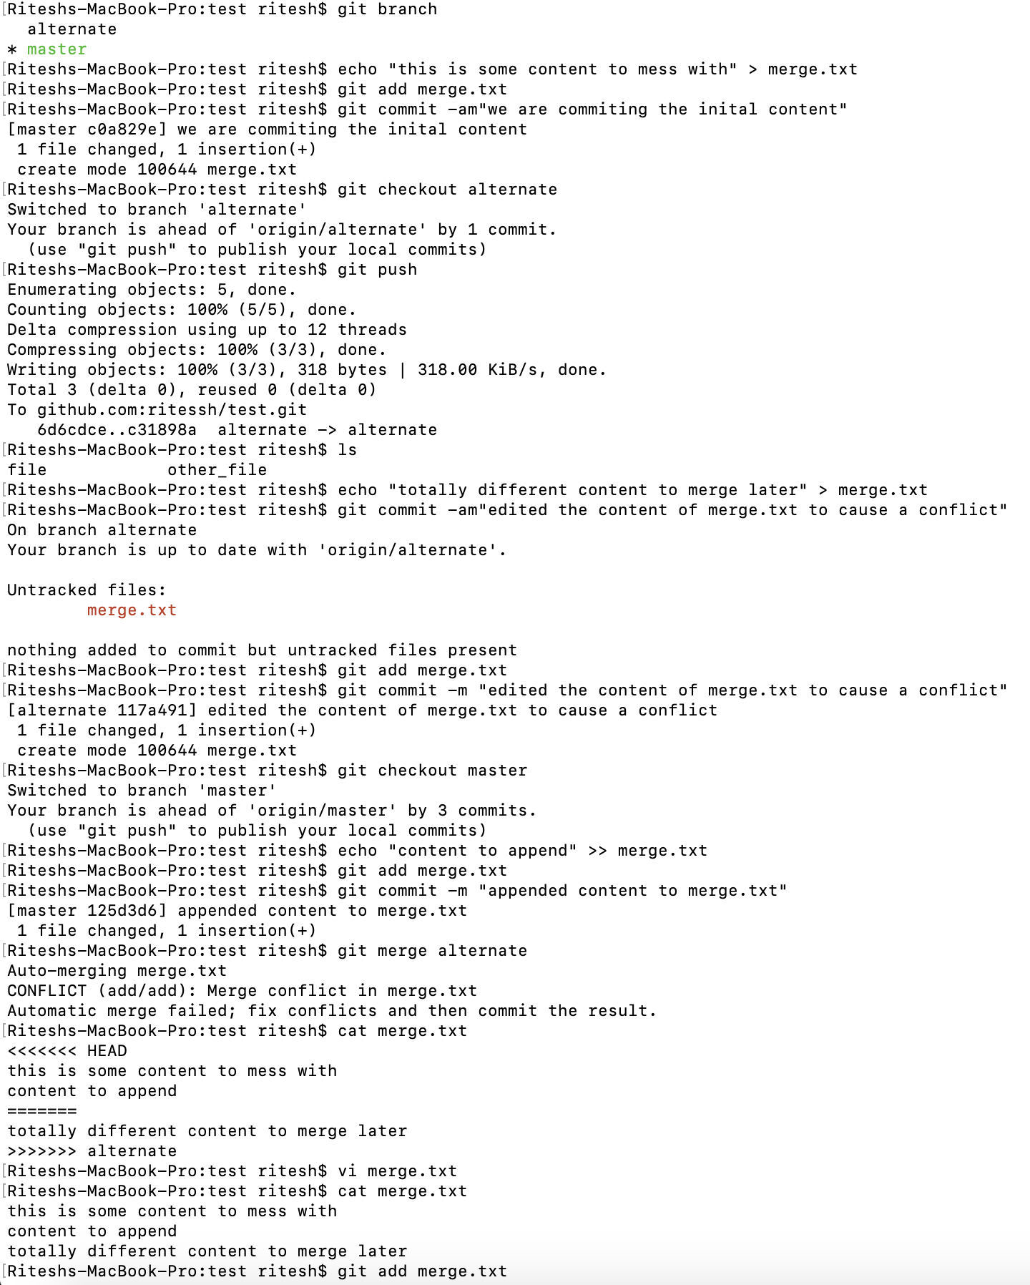
Branches, Diff and Merges – Cont’d…
Creating a merge conflict
Merging two branches (without conflict scenario)
# git checkout master
# echo "this is some content to mess with" > merge.txt
- run git add and git commit
# git checkout –b alternate
#echo "totally different content to merge later" > merge.txt
- run git add and git commit
#git checkout master
#echo "content to append" >> merge.txt
#git merge alternate
How to identify merge conflicts
#cat merge.txt <<<<<<< HEAD this is some content to mess with content to append ======= totally different content to merge later >>>>>>> alternate
Think of these new lines as "conflict dividers". The ======= line is the "centre" of the conflict. All the content between the centre and the <<<<<<< HEAD line is content that exists in the current branch master which the HEAD ref is pointing to. Alternatively all content between the centre and >>>>>>> alternate is content that is present in our merging branch.

